Slide 1
NextDorm
A High Fidelity Prototype

Slide 2
Projected Features
01
02
03
04
Meet Your Neighbors
Quickly find out about who lives in your building
Keep In The Loop
Get announcements about things in your community
Share Information
Tell your neighbors all about anything going on
All In One Place
Keep everything together in a user-friendly app

Slide 3
Main Functionalities
01
05
02
03
04
Log in as a student or RA and modify profile
(RAs) - Ban/Freeze users
Make a post/announcement/event
Reply to posts
Register for events

Slide 4
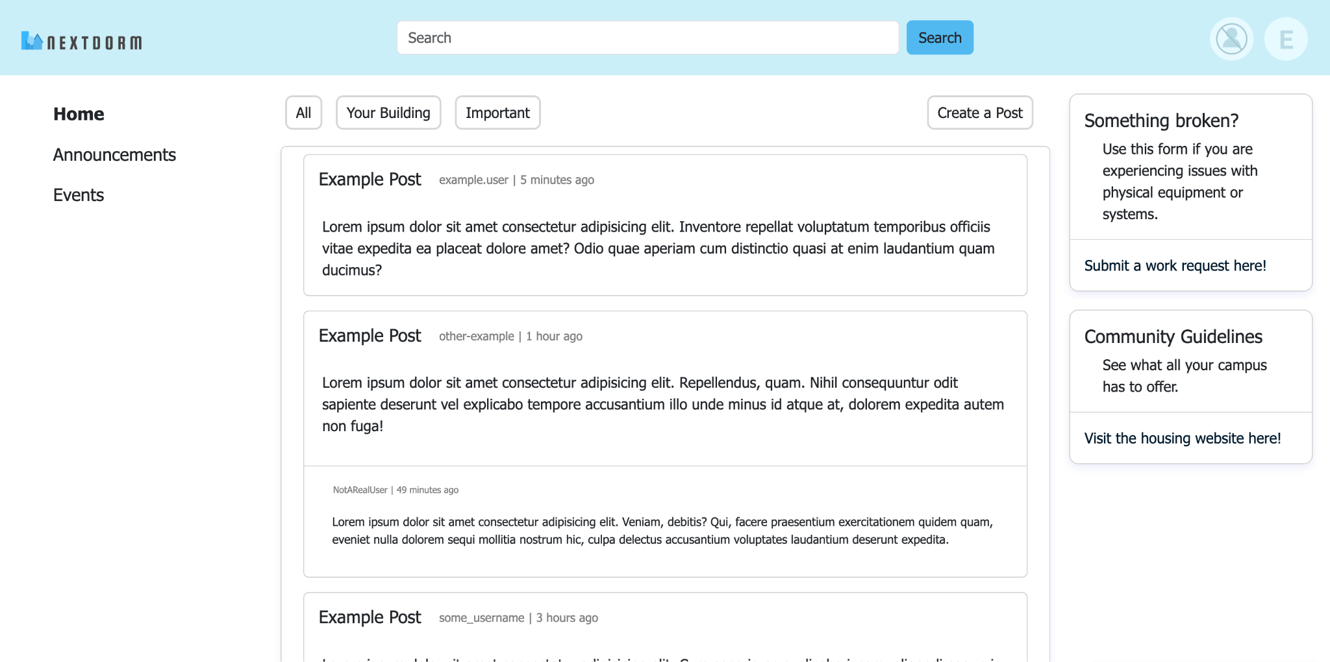
Stay Connected

Slide 5
Thanks!
Let’s take a look at that prototype

